Slide 1



ABAP on Hana s/4 Hana Training
Day 1
contact@anubhavtrainings.com

Slide 2

Introduction

Slide 3

ANUBHAV TRANINGS YOU WILL…. CONNECT | MIGRATE | UNDERSTAND | BUILD | DELIVER LEARN…. TOOL | TECHNOLOGY | TECHNIQUES
Anubhav Oberoy & Shubham Singh

Slide 4

Agenda – Day 1
Introduction to HANA
Introduction to IMCE( In-Memory Computing Engine )
Hardware and Software Innovation
Row v/s Column Store
Evolution of HANA with SAP solutions
Architecture of SAP HANA Platform
Describe How System Design Works

Slide 5
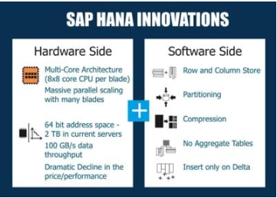
What is SAP HANA?
SAP HANA (high-performance analytic appliance) is an application that uses in-memory database technology that allows the processing of massive amounts of real-time data in a short time. The in-memory computing engine allows HANA to process data stored in RAM as opposed to reading it from a disk.
INNOVATIONS IN HANA
Several SAP HANA developers have made significant innovations in IT and in business models. Because of its in-memory approach, SAP HANA enables both hardware and software innovations which are unparalleled, replacing traditional databases in many spheres of business world! On the hardware side, SAP HANA facilitates Multi-Core Architecture (8×8 core CPU per blade), huge parallel scaling with several blades, 64 bit address space – 2 TB in current servers, data throughput as high as 100 GB/s, cost effectiveness and so on. On the software side, SAP HANA enables columnar data storage, partitioning, compression, eliminating aggregate tables, to name a few
01
Software Innovation
02
Hardware Innovation

Slide 6
Hardware & Software Innovation
Hardware innovations
Drastic reduction in memory price
Ability to fabricate large memory in small chips
Multi-core CPU
Interruptible power supply
64-bit OS
Specialized hardware which even process data in upper cache of CPU
HANA installation only works on specialized hardware certified by SAP – HP, Lenovo, Dell
Software Innovations
Able to compress data and store
Row store v/s Column Store
Able to use the OS level virtualization
Process data parallel
Insert-only approach
No Aggregation

Slide 7
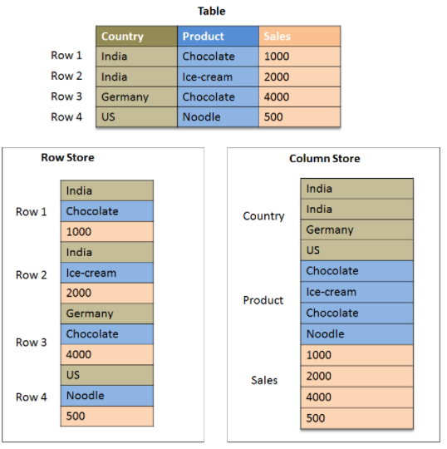
Row Store v/s Column Store
At a basic level, row stores are great for transaction processing. Column stores are great for highly analytical query models. Row stores have the ability to write data very quickly, whereas a column store is awesome at aggregating large volumes of data for a subset of columns.

Slide 8
Row Store v/s Column Store
Timestamp – Insert Only
If there is a need to read all the columns and all the rows every time. SELECT * unavoidable
.
01
01
Reads frequently and requires Agg.
If table gets changed so frequently
and has low volume of data
02
02
we should go columns provided not all columns required all times.
Table has large no. of UNIQUE values
03
03
Data volume is too high and we have large no. of non-unique (repeating)
Typically guideline for row store is more strict.
04
04
In any ERP system 70% read, 30%, Transaction and master table
Trainer: Anubhav Oberoy & Shubham Singh

Slide 9
Strategies with HANA
ECC
BW 7.31>
HANA driver
Other DB
HANA
Secondary
SAP HANA 1.0SP3
BW on HANA (Project Orange )
Side-car Scenario
SAP NW7.4SP2
S/4HANA
ABAP
ABAP on HANA
Any DB / HANA DB
1.0 SP6
HANA DB

Slide 10
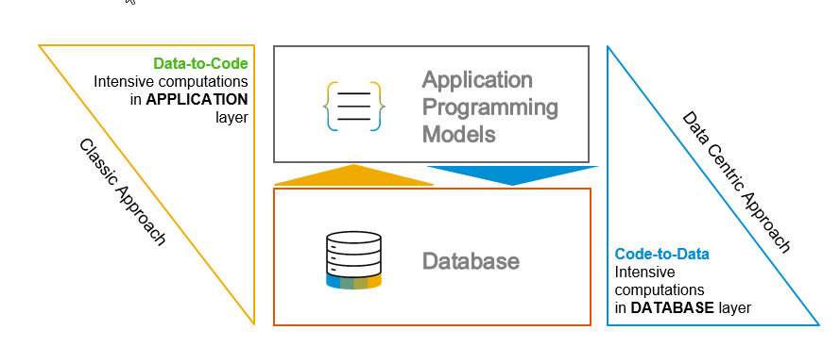
S/4 HANA, Suite on HANA and ABAP on HANA
Suite on HANA – Replace existing Any DB with HANA – SAP Product
S/4HANA – is also a product which is successor of Suite on HANA, Only runs on HANA – 2029 (all companies will be S/4)
ABAP on HANA – Technology on which these products are designed
Code push down
Code-to-data-paradigm
Most of the processing is pushed down to DB

Slide 11
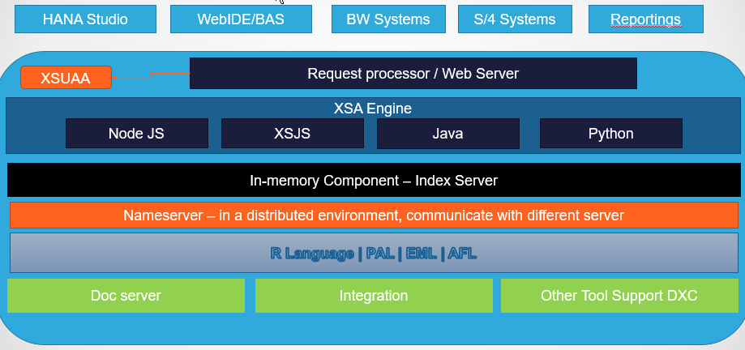
SAP HANA Architecture
SAP HANA System Architecture Overview. An SAP HANA system comprises multiple isolated databases and may consist of one host or a cluster of several hosts. An SAP HANA system is identified by a single system ID (SID) and contains one or more tenant databases and one system database.

Slide 12

Index server
ABAP, BW, Browser, Tool, Analytic App connects to SAP HANA Platform
XSUAA
Connection and Session manager
Session pool
Session pool
Session pool
Request processing and Execution Control
SQL processor
(DML)
MDX Engine
Store Procedure Engine (SQL Script)
Planning Engine
Join Engine
OLAP Engine
Calculation Engine
In-memory Store
Row Store
Column Store
Max DB (Secondary Store)
Page Management
Logging
www.anubhavtrainings.com

Slide 13
How system Design Work
Data is new Gold
Miami
NYC
ECC System
ORAFIN
Santa Clara
Kings County
Salesforce.com
S/4HANA (Read and Write) – Analytics+Trans
DB
Workday
ETL = Extraction Transformation and Loading
SLT, BODS, DXC, ..
SAP BOBJ
Data modeling
OLAP
Online Analytic Processing
SAP Crystal Report
Business Warehouse
(SAP BW)
Power BI, Tableu
SAP Analytics Cloud
In 2008, where there was a recession, how was my sales pattern
What was the sales during leap years
How many iPhone I sold last thanks giving days
If we got 10k leads from marketing, how many labors I need to fulfil demand
S/4HANA

Slide 14

End of Day 1
Trainer: Anubhav Oberoy & Shubham Singh

Slide 15

Trainer: Anubhav Oberoy & Shubham Singh

Slide 16
THANK YOU
If you cannot do
great things, do small things in a great way.
Anubhav Oberoy & Shubham Singh
https://www.anubhavtrainings.com

Slide 17


We’re committed to empower you to be
Most Desirable Resource
through powerful training solutions.
We build the workforce of the future.
250+
Corporate Clients
30,000+
Learners Trained
25000+
Learners Placed
FREE WEBINARS
Sign up for free webinars with industry experts every fortnight!
Enroll Now!
Contact us today!
https://anubhavtrainings.com/

Slide 18




More from AnubhavTrainings.com

